Slide 1
STUDENT RECORD MANAGEMENT SYSTEM Prepared by: CHINTAN VEKARIYA-19DCS156
WEB DEVELOPMENT
DEPSTAR-CSE(SEM-4)
GUIDED BY:
PROF. AISHWARIYA MAM

Slide 2
Contents:
DEFINTION-MOTIVATION.
SCOPE OF SYSTEM.
PROBLEM STATEMENT AND SOLUTION.
LIST OF REQUIREMENTS.
TOOLS AND PLATFORM.
SOFTWARE REQUIREMENTS.
Flowcharts.
IMPLEMENTATIONS.
FUTURE SCOPE.

Slide 3
Definition:
Student record management system is designed to help manage the daily school activities of recording and maintaining by automating it. It is also known as the student information system (SIS) or school records system (SRS).
The system is equipped with a robust set of features like attendance tracking, library management, parents portal, etc. These tools help in managing the institute efficiently and accurately. In other words, it saves time, cut fees loss, and other wastages.
Most schools use student information systems (SIS) as a standalone tool and use different applications for other purposes like classroom management, online courses management, and more.

Slide 4
MOTIVATION:
As the current scenario prevails almost everywhere in colleges and schools, student management work is found to be done manually by the student counselors or professors.
There is lot of paper work going on everywhere for the same purpose i.e. attendance, lectures, meetings, classes etc.
To reduce this stuff we plan to build a native web application which performs this tasks to reduce human effort.

Slide 5
Scope of System:
An only authenticated user can have access to certain privileges.
Reduces the uses of hardcopy of papers.
Student information can be accessed and known and can be changed at anytime.
Manipulation of the data is possible.
Can be accessed anywhere and the details can be known with an authorized access only.

Slide 6
PROBLEM STATEMENT:
To maintain the student details of the students pursuing their education and get it updated regularly.
To allow student get track of there records.
Provide security aspect to the users so there is no malpractice done with the data that is confidential.

Slide 7
SOLUTION TO THE CURRENT PROBLEM:
As a solution to the current scenario a system can be developed where admin(authorized users) can get the whole access of the student data along with its all academic credential's.
For any purpose the data can be altered accordingly and the changes made to the data are permanent and updated everywhere so there is no inconsistency in data for various users.

Slide 8
Consolidated List of Requirements:
I have enhance the web application with security feature like login ID and password while we start the app.
This web app will be flexible and accessible anytime, anywhere via a PC and internet connection.
This app will have sustainability for the long time and will be able to work for longer time.
This app need lower requirements on the end user system and simplified architecture.

Slide 9
Tools and platform:
I have used PHP , HTML, CSS and Bootstrap for making this website.
For saving the data of students, we have used phpMyAdmin.
The entire website executes on the XAMPP server.
To Access the website we can use any type of web browser.

Slide 10
Hardware & software requirements:
It needs Most recent version of Google Chrome, Firefox, Internet Explorer, or safari.
Hardware Requirement:
CPU: Single Core 2.4 GHZ
RAM: 512 MB
Graphics Card: Intel or Nvidia
Hard Drive: 5 Gigabytes
Network: Broadband Recommended
Processor: Pentium
Operating System: Window(XP, Vista, 7, 8, 10), Mac OS, Linux, Unix.
Internet Connection with good speed.

Slide 11
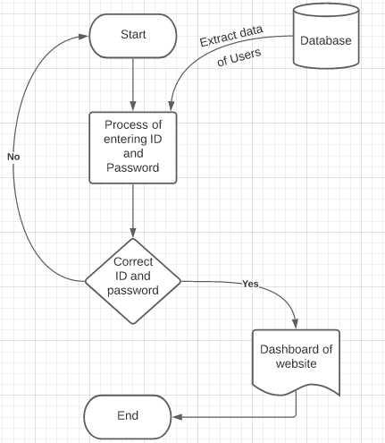
FLOWCHART (login page):

Slide 12
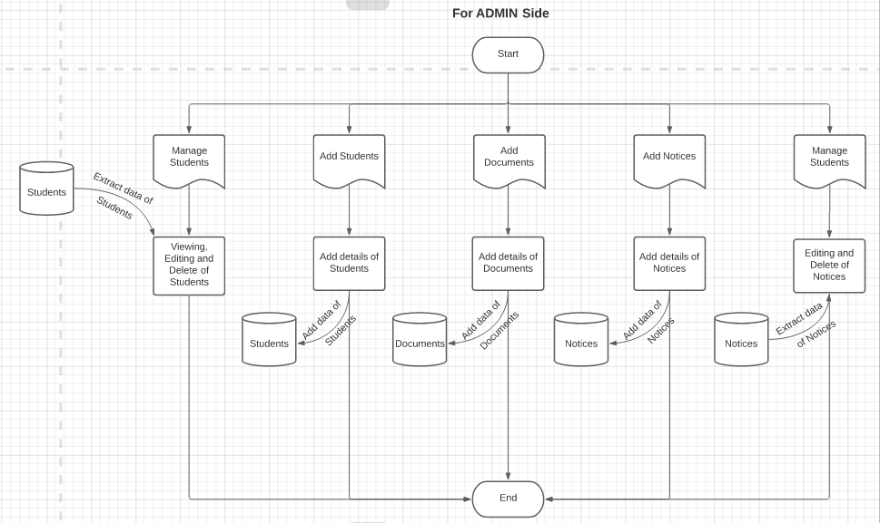
FLOWCHART (Admin side):

Slide 13
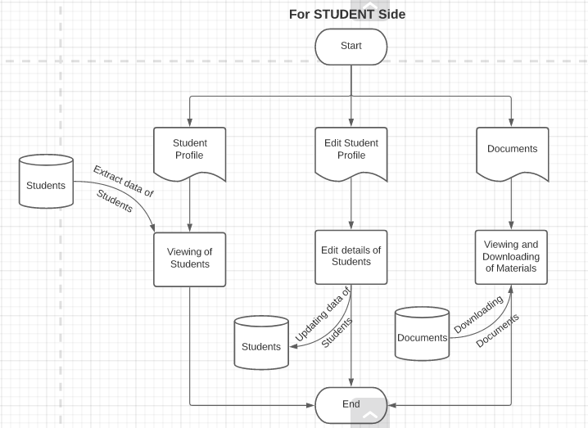
FLOWCHART (Student SIDE):

Slide 14
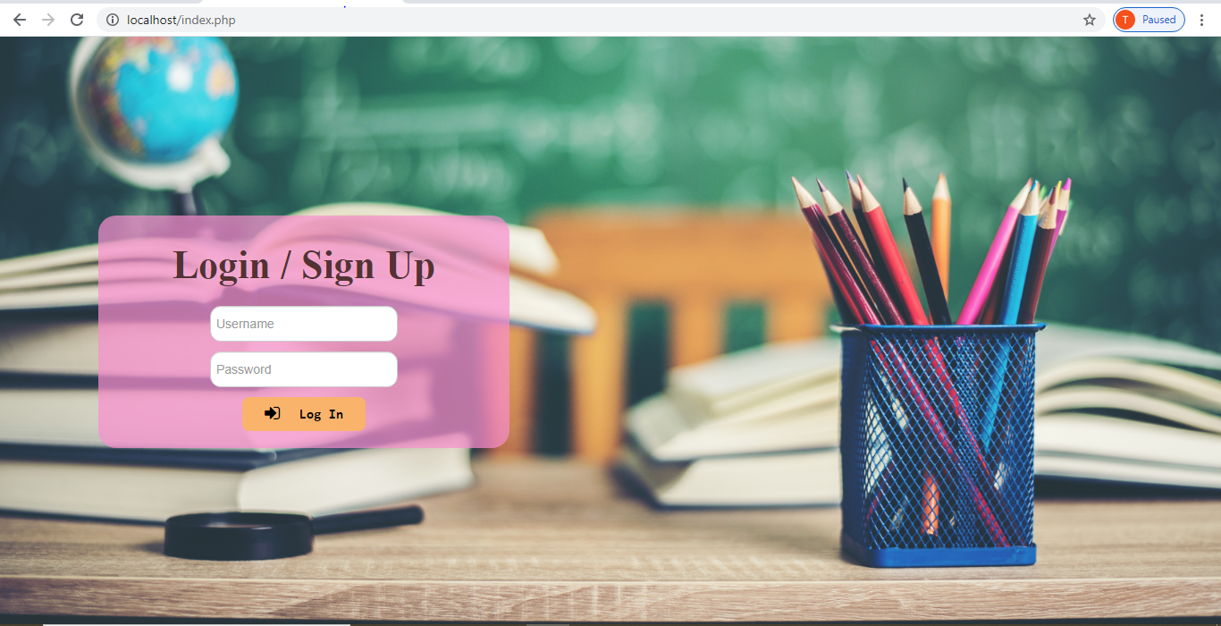
LOGIN/SIGN IN PAGE:

Slide 15
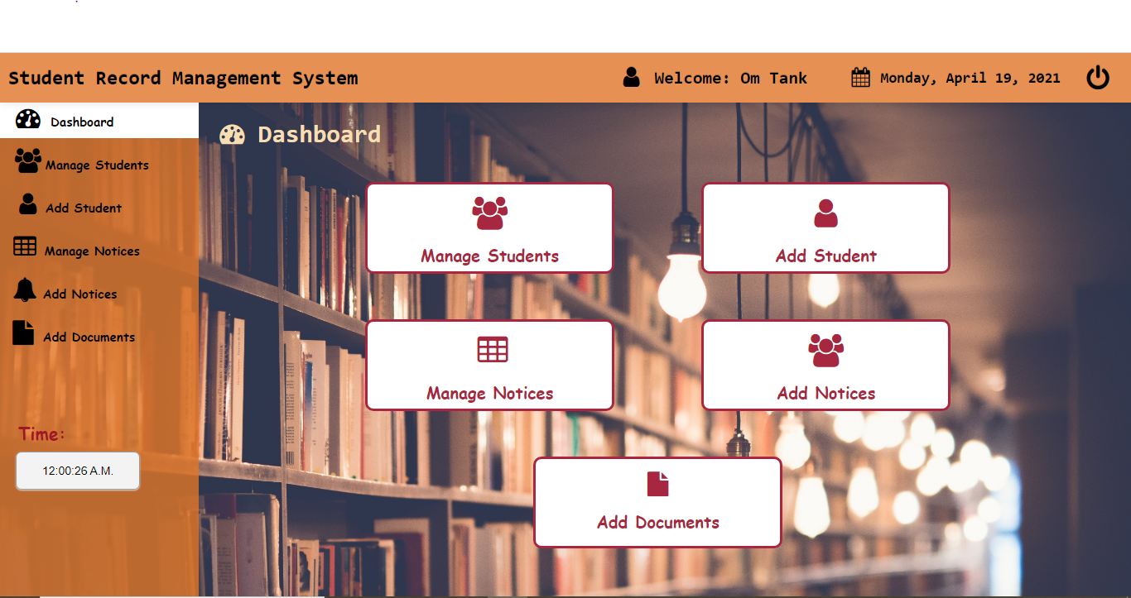
Home page:

Slide 16
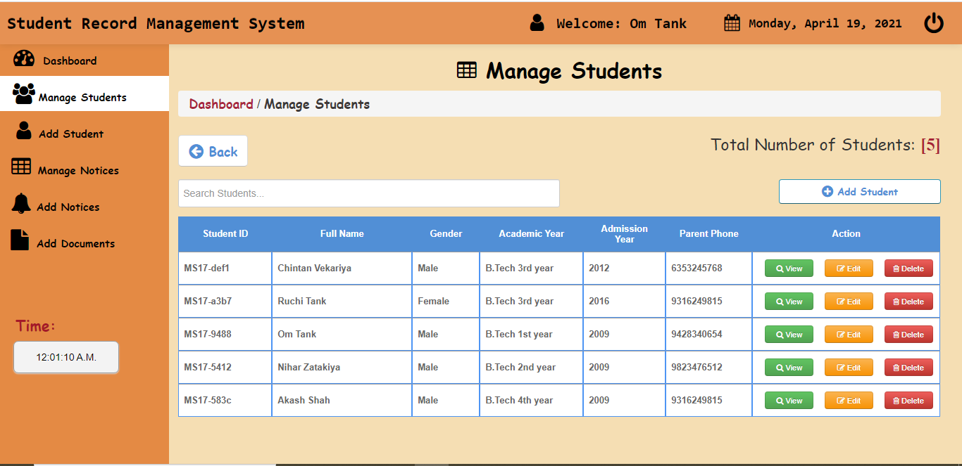
Implementation:

Slide 17
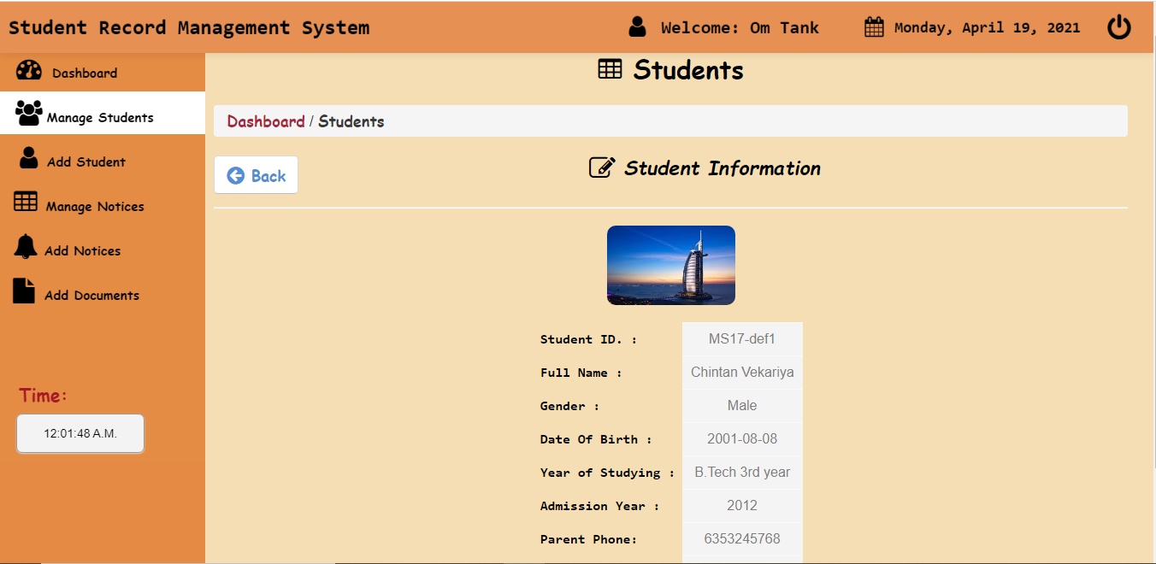
Implementation:

Slide 18
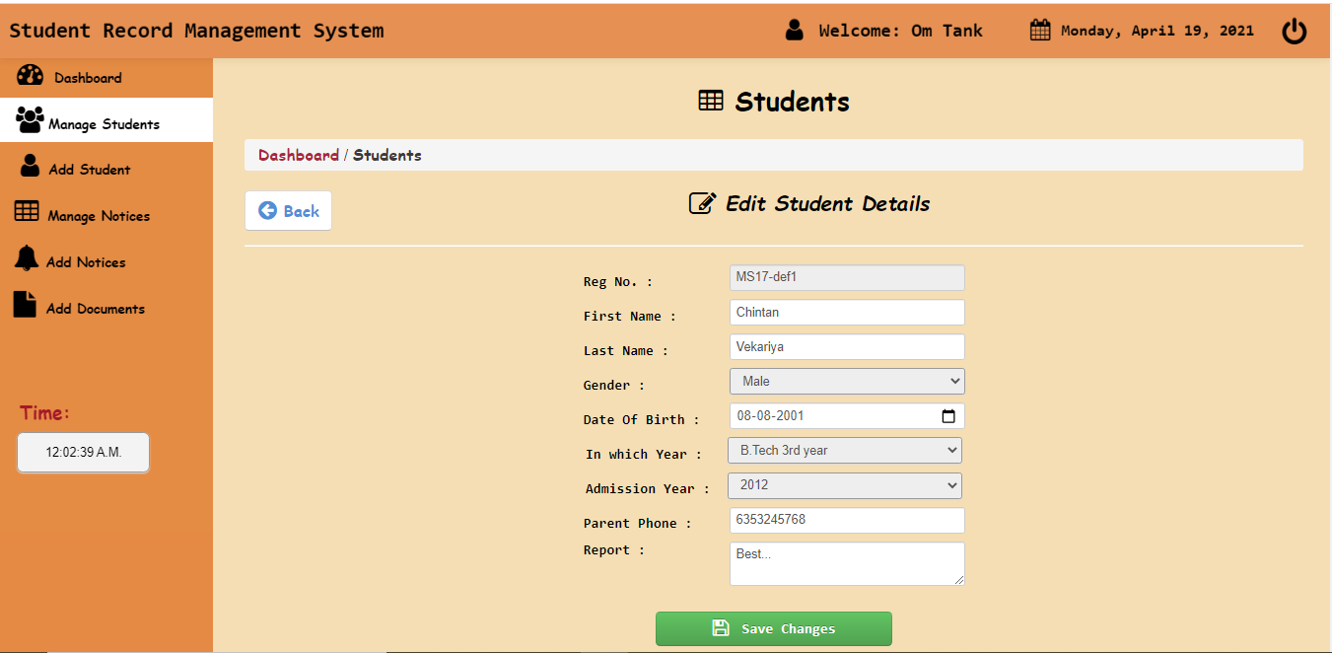
Implementation:

Slide 19
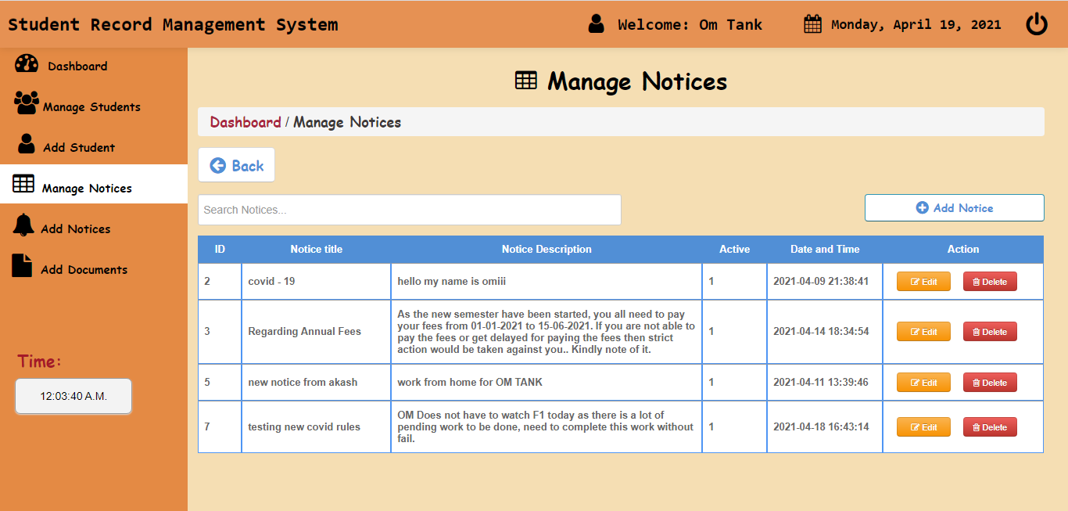
Implementation:

Slide 20
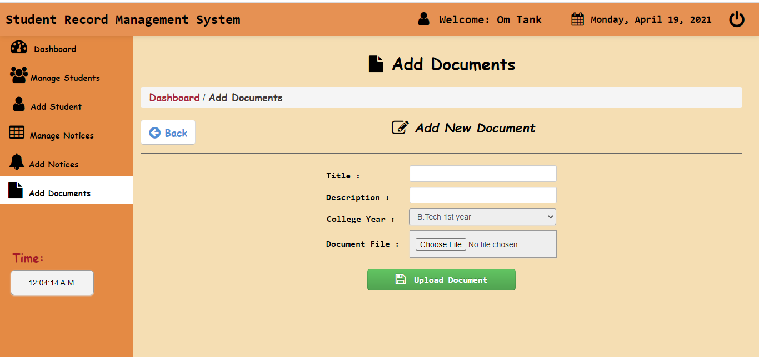
Implementation:

Slide 21
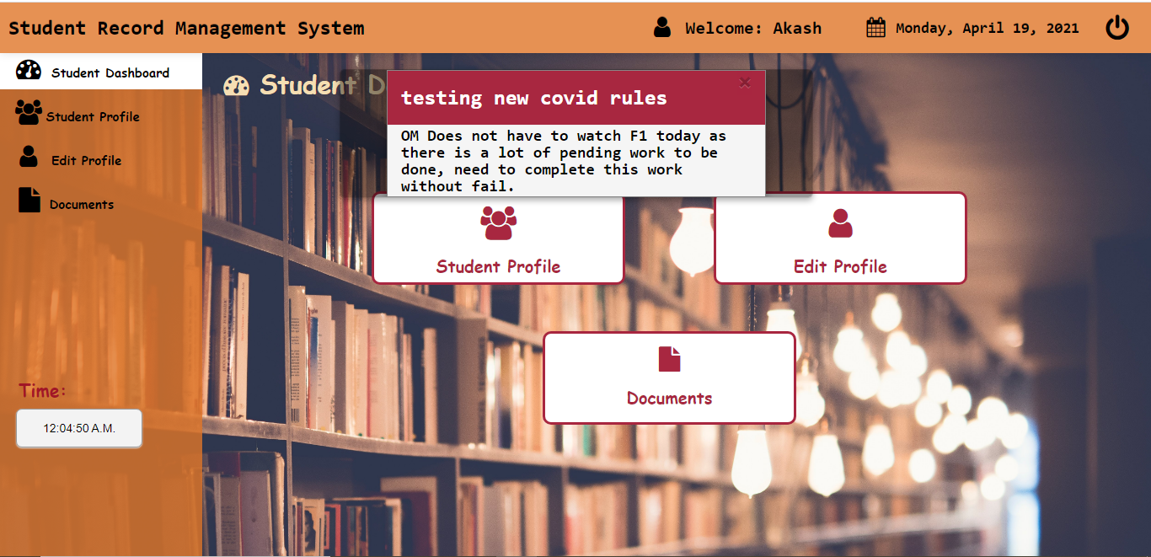
Student side:

Slide 22
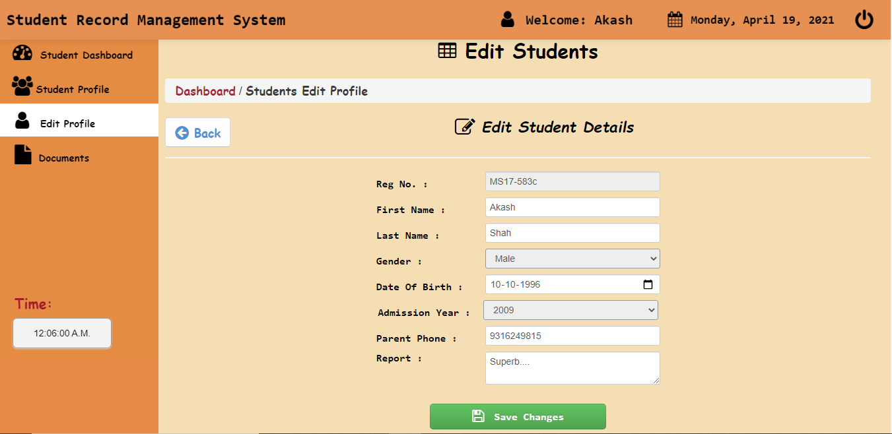
Implementation:

Slide 23
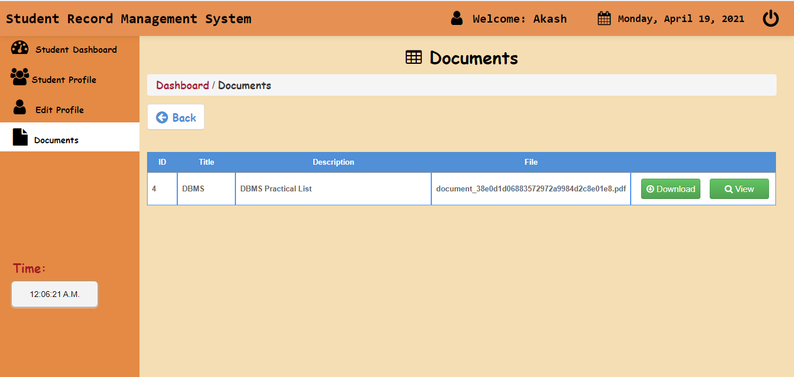
Implementation:

Slide 24
Future Scope:
Attendance can be filled and seen just in a single click.
Evaluation of lecture counting will be much easier.
Teachers and Students can see easily where the lecture is going to be held which makes it easier to see the current lecture and can save time.
In future, students can also be able to upload or download notes.
We will see the entire system more interactive and also be able to give statistics data.
We can run the entire system in any operating system and also we have an android application of this entire system.

Slide 25


